Slide 1
Turning Linear Models into Nonlinear Models using Kernel Methods
CS771: Introduction to Machine Learning
Piyush Rai

Slide 2
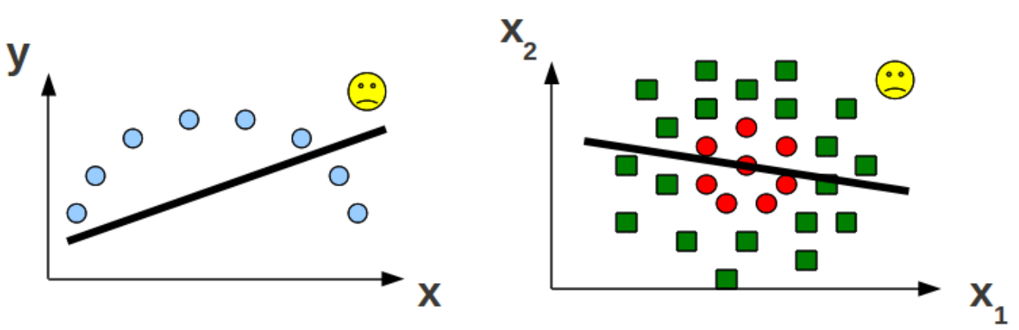
Linear Models
Nice and interpretable but can’t learn “difficult” nonlinear patterns
So, are linear models useless for such problems?

Slide 3

Linear Models for Nonlinear Problems
Consider the following one-dimensional inputs from two classes
Can’t separate using a linear hyperplane
$$x$$

Slide 4
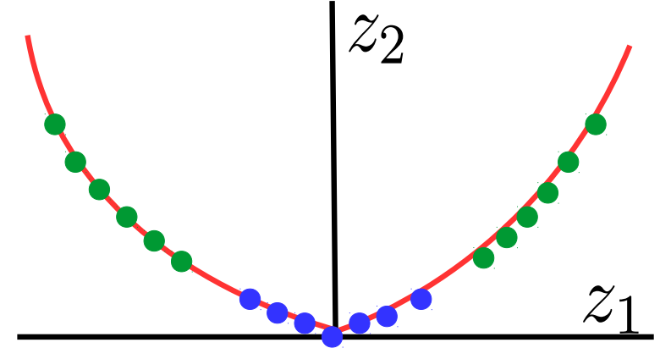

Linear Models for Nonlinear Problems
Consider mapping each $x$ to two-dimensions as $x→ z = \left[z_{1},z_{2}\right]=[x,x^{2}]$
Classes are now linearly separable in the two-dimensional space
Linear hyperplane

Slide 5
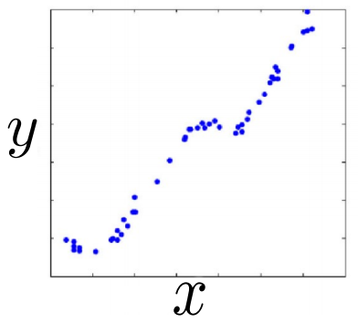
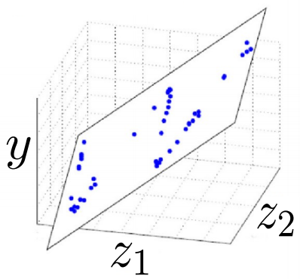

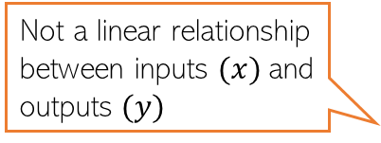
Linear Models for Nonlinear Problems
The same idea can be applied for nonlinear regression as well
$$x→ z = \left[z_{1},z_{2}\right]=[x,cos(x)]$$
Not a linear relationship between inputs $(x)$and outputs $(y)$
A linear regression model will not work well
A linear regression model will work well with this new two-dim representation of the original one-dim inputs

Slide 6
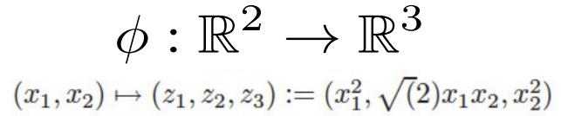
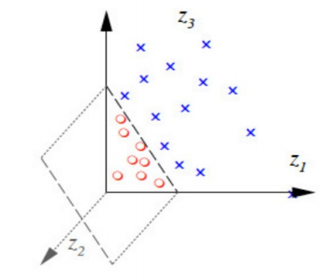
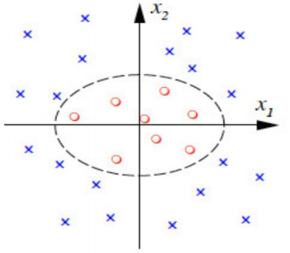

Linear Models for Nonlinear Problems
Can assume a feature mapping $φ$ that maps/transforms the inputs to a “nice” space
.. and then happily apply a linear model in the new space!
The linear model in the new feature space corresponds to a nonlinear model in the original feature space

Slide 7
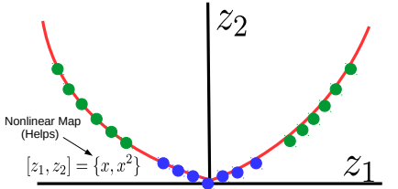
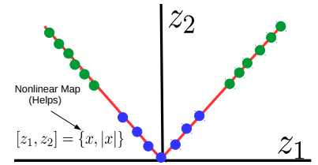
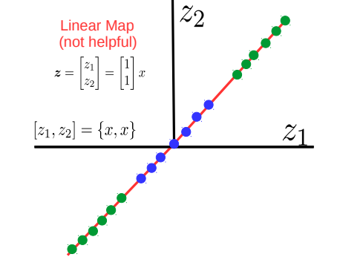
Not Every Mapping is Helpful
Not every higher-dim mapping helps in learning nonlinear patterns
Must be a nonlinear mapping
For the nonlin classfn problem we saw earlier, consider some possible mappings

Slide 8

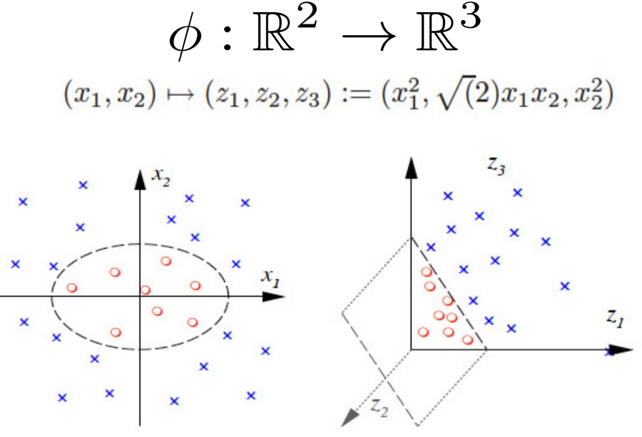

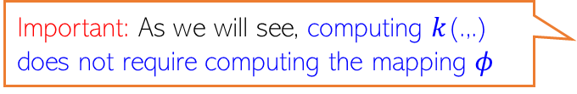

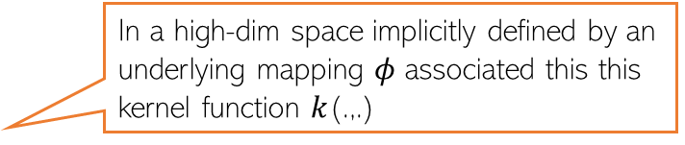
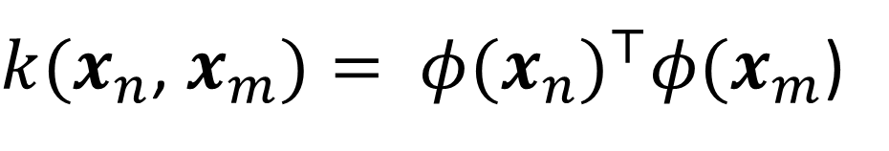
How to get these “good” (nonlinear) mappings?
Can try to learn the mapping from the data itself (e.g., using deep learning - later)
Can use pre-defined “good” mappings (e.g., defined by kernel functions - today’s topic)
Kernel: A function $k$(.,.) that gives dot product similarity b/w two inputs, say $x_{n}$ and $x_{m}$
Thankfully, using kernels, you don’t need to compute these mappings explicitly
Even if I knew a good mapping, it seems I need to apply it for every input. Won’t this be computationally expensive?
The kernel will define an “implicit” feature mapping
Important: The idea can be applied to any ML algo in which training and test stage only require computing pairwise similarities b/w inputs
Also, the number of features will increase? Will it not slow down the learning algorithm?
In a high-dim space implicitly defined by an underlying mapping $φ$ associated this this kernel function $k$(.,.)
Important: As we will see, computing $k$(.,.) does not require computing the mapping $φ$
$k(x_{n}$, $x_{m})= {φ(x_{n})}^{⊤}φ(x_{m}$)

Slide 9
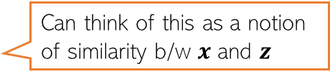






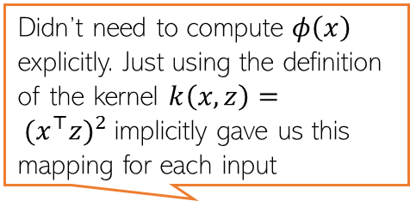


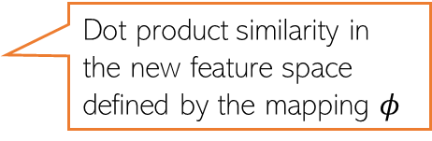
Kernels as (Implicit) Feature Maps
Consider two inputs (in the same two-dim feature space): $x = [x_{1},x_{2}], z = [z_{1},z_{2}]$
Suppose we have a function $k(.,.)$ which takes two inputs $x$ and $z$ and computes
Also didn’t have to compute ${φ\left(x\right)}^{⊤}φ(z)$. Defn $k\left(x,z\right)= {(x^{⊤}z)}^{2}$ gives that
Called the “kernel function”
Can think of this as a notion of similarity b/w $x$ and $z$
This is not a dot/inner product similarity but similarity using a more general function of $x$ and $z$ (square of dot product)
$$k\left(x,z\right)= {(x^{⊤}z)}^{2}$$
Didn’t need to compute $φ\left(x\right)$ explicitly. Just using the definition of the kernel $k\left(x,z\right)= {(x^{⊤}z)}^{2}$implicitly gave us this mapping for each input
$= {(x_{1}z_{1}+x_{2}z_{2})}^{2}$
$=x_{1}^{2}z_{1}^{2}+x_{2}^{2}z_{2}^{2}+2x_{1}x_{2}z_{1}z_{2}$
Remember that a kernel does two things: Maps the data implicitly into a new feature space (feature transformation) and computes pairwise similarity between any two inputs under the new feature representation
Thus kernel function $k\left(x,z\right)= {(x^{⊤}z)}^{2}$
implicitly defined a feature mapping $φ$such that for $x = [x_{1},x_{2}]$ , $φ\left(x\right)=\left(x_{1}^{2},\sqrt{2}x_{1}x_{2},x_{2}^{2}\right)$
$= {\left(x_{1}^{2},\sqrt{2}x_{1}x_{2},x_{2}^{2}\right)}^{⊤}(z_{1}^{2},\sqrt{2}z_{1}z_{2},z_{2}^{2})$
$= {φ\left(x\right)}^{⊤}φ(z)$
Dot product similarity in the new feature space defined by the mapping $φ$

Slide 10
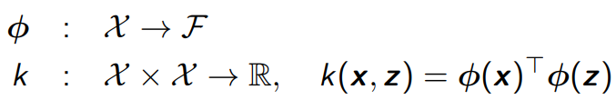
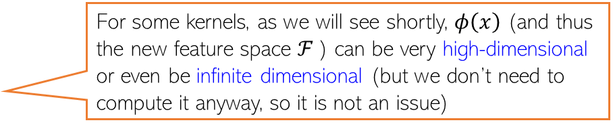
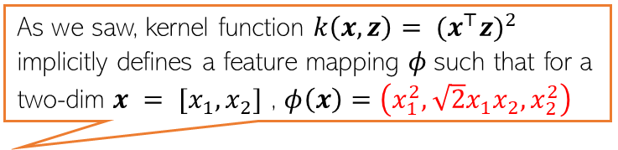
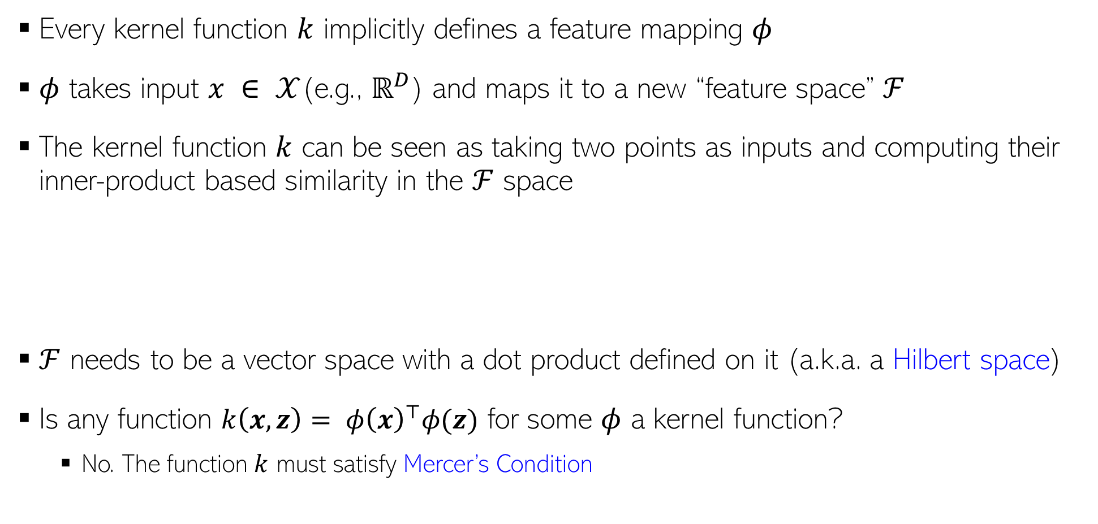
Kernel Functions
As we saw, kernel function $k\left(x,z\right)= {(x^{⊤}z)}^{2}$
implicitly defines a feature mapping $φ$such that for a two-dim $x = [x_{1},x_{2}]$ , $φ\left(x\right)=\left(x_{1}^{2},\sqrt{2}x_{1}x_{2},x_{2}^{2}\right)$
Every kernel function $k$ implicitly defines a feature mapping $φ$
$φ$ takes input $x ∈ 𝒳$(e.g., $ℝ^{D}$) and maps it to a new “feature space” $ℱ$
The kernel function $k$ can be seen as taking two points as inputs and computing their inner-product based similarity in the $ℱ$ space
$ℱ$ needs to be a vector space with a dot product defined on it (a.k.a. a Hilbert space)
Is any function ${k\left(x,z\right)= φ\left(x\right)}^{⊤}φ(z)$ for some $φ$ a kernel function?
No. The function $k$ must satisfy Mercer’s Condition
For some kernels, as we will see shortly, $φ\left(x\right)$ (and thus the new feature space $ℱ$) can be very high-dimensional or even be infinite dimensional (but we don’t need to compute it anyway, so it is not an issue)

Slide 11
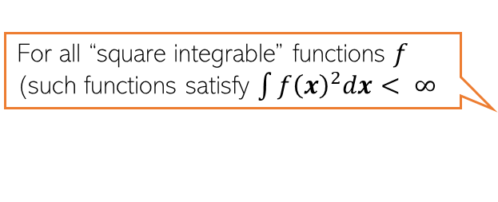
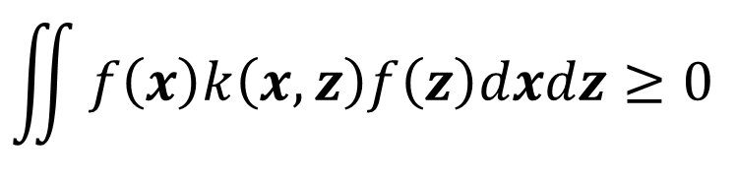

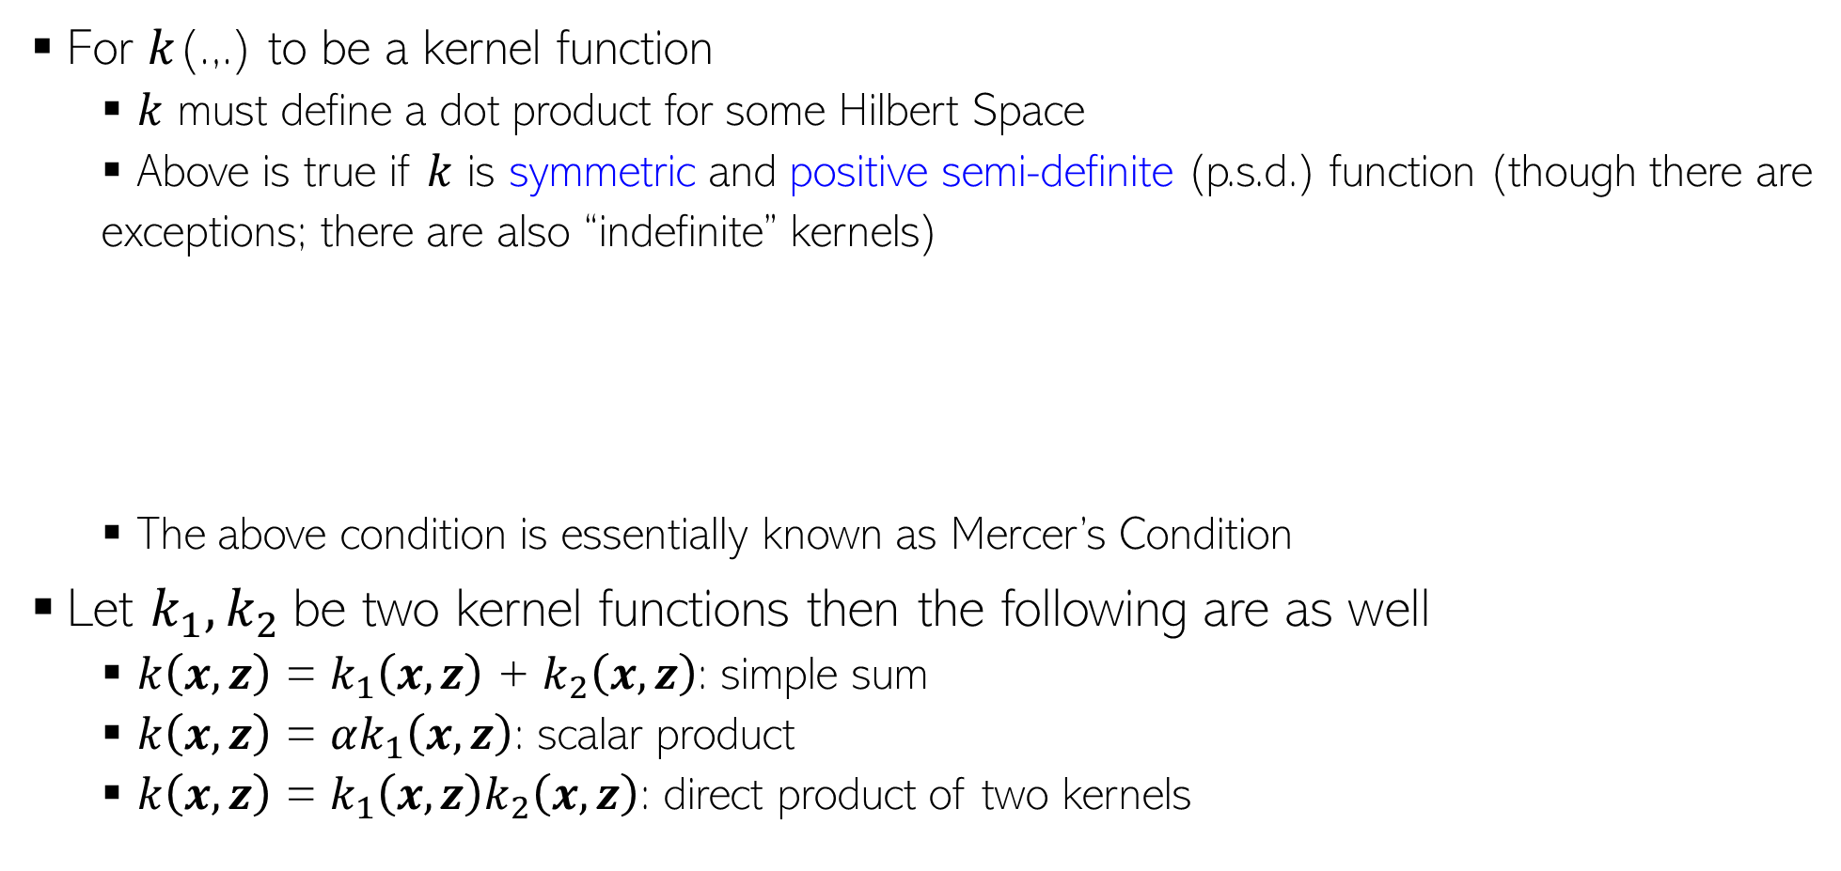
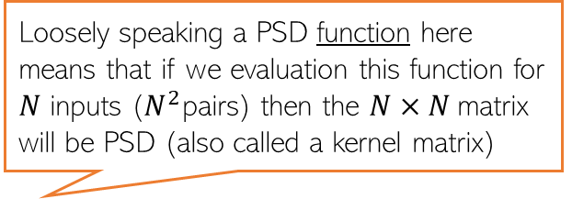
Kernel Functions
For $k$(.,.) to be a kernel function
$k$ must define a dot product for some Hilbert Space
Above is true if $k$ is symmetric and positive semi-definite (p.s.d.) function (though there are
exceptions; there are also “indefinite” kernels)
The above condition is essentially known as Mercer’s Condition
Let $k_{1}, k_{2}$be two kernel functions then the following are as well
$k\left(x,z\right)$ = $k_{1}\left(x,z\right)$ + $k_{2}\left(x,z\right)$: simple sum
$k\left(x,z\right)$ = $αk_{1}\left(x,z\right)$: scalar product
$k\left(x,z\right)$ = $k_{1}\left(x,z\right)k_{2}\left(x,z\right)$: direct product of two kernels
Loosely speaking a PSD function here means that if we evaluation this function for $N$ inputs ($N^{2}$pairs) then the $N×N$matrix will be PSD (also called a kernel matrix)
$$k\left(x,z\right)=k(z,x)$$
For all “square integrable” functions $f$ (such functions satisfy $\int{f{\left(x\right)}^{2}dx< ∞}$
$$\iint{f\left(x\right)k\left(x,z\right)f\left(z\right)dxdz≥0 }$$
Can easily verify that the Mercer’s Condition holds
Can also combine these rules and the resulting function will also be a kernel function

Slide 12
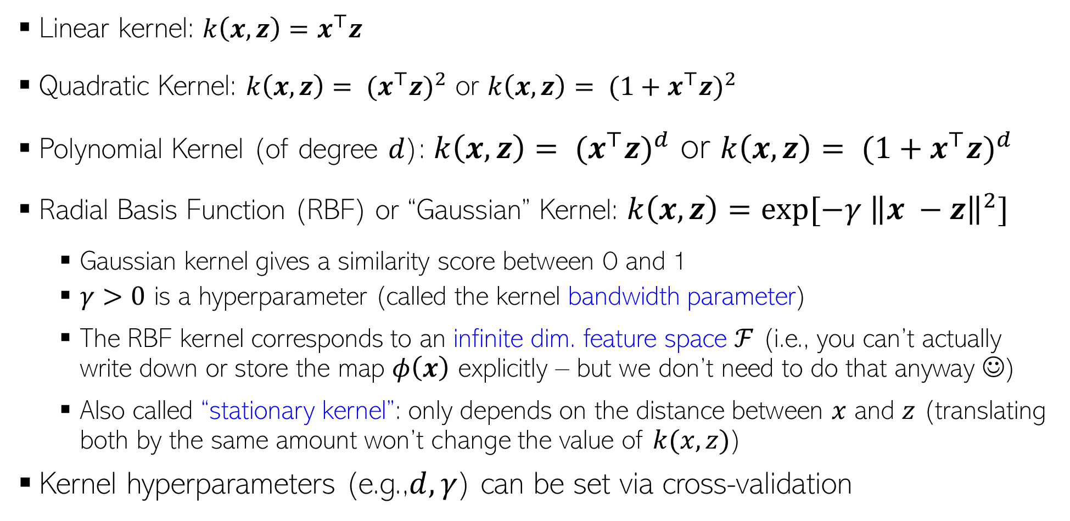
Some Pre-defined Kernel Functions
Several other kernels proposed for non-vector data, such as trees, strings, etc
Remember that kernels are a notion of similarity between pairs of inputs
Linear kernel: ${k\left(x,z\right)=x}^{⊤}z$
Quadratic Kernel: $k\left(x,z\right)= {(x^{⊤}z)}^{2}$ or $k\left(x,z\right)= {(1+x^{⊤}z)}^{2}$
Polynomial Kernel (of degree $d$): $k\left(x,z\right)= {(x^{⊤}z)}^{d}$ or $k\left(x,z\right)= {(1+x^{⊤}z)}^{d}$
Radial Basis Function (RBF) or “Gaussian” Kernel: $k\left(x,z\right)=exp[−γ {\left\|x −z\right\|}^{2}]$
Gaussian kernel gives a similarity score between 0 and 1
$γ>0$ is a hyperparameter (called the kernel bandwidth parameter)
The RBF kernel corresponds to an infinite dim. feature space $ℱ$ (i.e., you can’t actually write down or store the map $φ\left(x\right)$ explicitly – but we don’t need to do that anyway ☺)
Also called “stationary kernel”: only depends on the distance between $x$ and $z$ (translating both by the same amount won’t change the value of $k(x, z)$)
Kernel hyperparameters (e.g.,$d, γ$) can be set via cross-validation
Kernels can have a pre-defined form or can be learned from data (a bit advanced for this course)
Controls how the distance between two inputs should be converted into a similarity

Slide 13

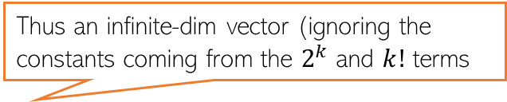


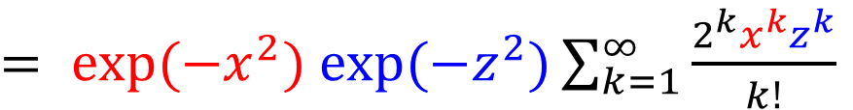
RBF Kernel = Infinite Dimensional Mapping
We saw that the RBF/Gaussian kernel is defined as $k\left(x,z\right)=exp[−γ {\left\|x −z\right\|}^{2}]$
Using this kernel corresponds to mapping data to infinite dimensional space
Here $φ\left(x\right)=[exp\left(−x^{2}\right)x^{1},exp\left(−x^{2}\right)x^{2}$, $exp\left(−x^{2}\right)x^{3},…,exp\left(−x^{2}\right)x^{∞}]$
But again, note that we never need to compute $φ\left(x\right)$ to compute $k\left(x,z\right)$
$k\left(x,z\right)$ is easily computable from its definition itself ($exp[−{\left(x−z\right)}^{2}]$ in this case)
$$k\left(x,z\right)= exp[−{\left(x−z\right)}^{2}]$$
$$(assuming γ=1 and x and z to be scalars)$$
$= exp(−x^{2})$ $exp(−z^{2})exp(2xz)$
$= exp(−x^{2})$ $exp(−z^{2})\sum_{k=1}^{∞}{\frac{2^{k}x^{k}z^{k}}{k!}}$
$${=φ\left(x\right)}^{⊤}φ(z)$$
Thus an infinite-dim vector (ignoring the constants coming from the $2^{k}$ and $k!$ terms

Slide 14
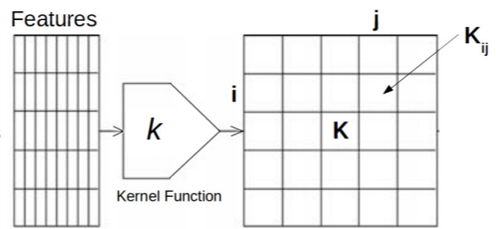
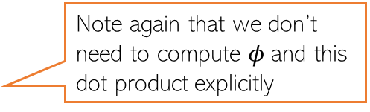

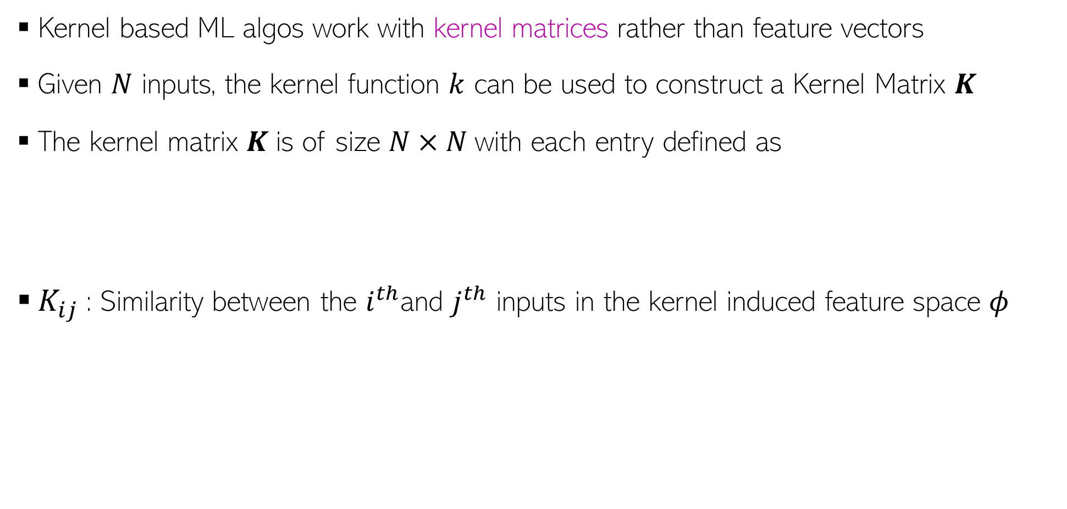
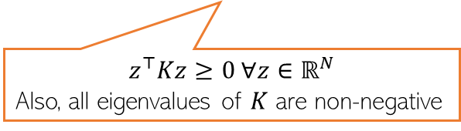

Kernel Matrix
Kernel based ML algos work with kernel matrices rather than feature vectors
Given $N$ inputs, the kernel function $k$ can be used to construct a Kernel Matrix $K$
The kernel matrix $K$is of size $N×N$with each entry defined as
$K_{ij}$: Similarity between the $i^{th}$and $j^{th}$ inputs in the kernel induced feature space $φ$
Note again that we don’t need to compute $φ$and this dot product explicitly
$K_{ij}=k\left(x_{i},x_{j}\right)$ ${=φ\left(x_{i}\right)}^{⊤}φ(x_{j})$
$K$ is a symmetric and positive semi-definite matrix
Inputs
$$z^{⊤}Kz≥0 ∀z∈ℝ^{N}$$
Also, all eigenvalues of $K$ are non-negative
Feature Matrix
Kernel Matrix

Slide 15
Coming up next..
Applying kernel methods for SVM and ridge regression

